Slide 1


Story and Task Issue Analysis for Agile Machine Learning Projects
Samsung R&D Institute India - Bangalore
Kushal Singla, Joy Bose, Arpitha A S and Vinayak T M

Slide 2
The talk structure of the presentation is as follows:
Problem Statement
Backlog Quality Analysis
Data Collection
Model Training
Test Results
Inferences and Suggestions
Recommendations and Future work

Slide 3
Problem Statement
The rise in the number of machine learning, artificial intelligence related projects using Agile methodology has increased.
Need in understanding the correlation and effectiveness between Machine Learning and Agile is important.
Based on the Data analysis:
A story classification using machine learning algorithm (SVM) for Project issues tracking data of several Machine learning projects & Non-machine learning projects Scrum teams
We have identified the patterns with respect to:
Composition of tasks type
Product Backlog quantity
Story Quality
Words used
Post analysis, paper proposes a few ways of better execution for Machine Learning projects following scrum (agile).

Slide 4
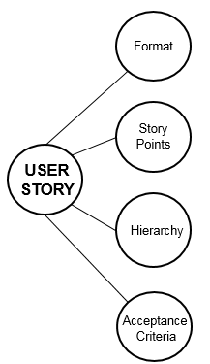
Backlog Quality Analysis
Observed that many teams tend to ignore the quality and many quality issues are reported at later stage of development cycle.
They dramatically drop in importance as team progress in agile, while some keep the quality all time and some teams are unaware of the backlog quality.
Backlog and the stories quality are not analyzed using a ML model.
Story/ Backlog quality analysis requires the understanding of the domain/ module, user roles, relation of the acceptance criteria with story, etc. This is the gap we seek to fill in this paper.

Slide 5
Data Collection
Data over a period of 6 months from multiple teams of two kinds:
Exclusively machine learning projects and consisting mainly of data engineers and data scientists
Conventional software projects not involving machine learning specifically consisting largely of software engineers.
We collected data from 59 scrum projects for 4 sprints with a total of 1022 stories.
Selected Scrum projects are of type Development, Research, and Optimization.
The Scrum projects are taken from a variety of domains including Internet of Things (IoT), Voice Service, Payment, Security, Camera, OS Platform, Cloud platform, Big data analysis, Services, etc.
The total dataset is divided into Training (80%) and Test(20%) datasets.

Slide 6
Model Training
Support vector machine (SVM) model is used for the classification of the story text into good or bad. SVM is commonly used as a fast and reasonably accurate machine learning algorithm suitable for most classification tasks.
The features we use are the following:
Story title
Story description text
Story acceptance criteria
Title length
Description length
Acceptance criteria length
Title punctuation count
Description punctuation count
Acceptance criteria punctuation count
Is title same as description
The preprocessing steps we use are the following:
Story title: stop word removal
Story description text: stop word removal
Story acceptance criteria: stop word removal

Slide 7
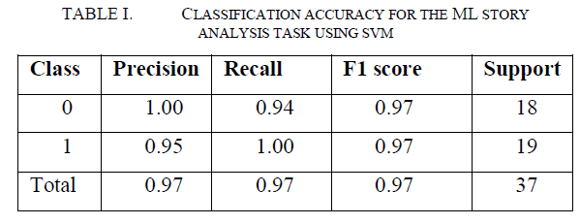
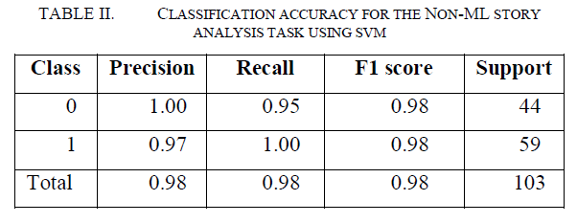
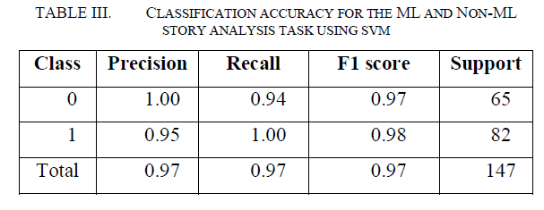
Test Results
The results of the classification task for the stories of the test set (20% of the total dataset) for
ML
Non-ML
Combined (ML and Non ML)
Overall F1 scores of 97%, indicating the SVM model has been able to classify the data accurately.
The class for the Bad Story -> Class label 0
The class with the Good Story -> Class label 1

Slide 8
Inferences and Suggestions
Good ML stories have in common the following features:
• They have a good count of acceptance criteria
• Their title length is sufficiently high, meaning the story titles are sufficiently descriptive
• They use technical terms to make the story more precise. Terms are such as Integration, risk & licensing.
Bad stories on the other hand, have the following salient features:
• The quality of the story descriptions is poor
• The domain of the story is often not clear. The technical terms such as Demo is used.
Good Non-ML stories have in common the following features:
• They have a good count of acceptance criteria
• Their title length is sufficiently high, meaning the story titles are sufficiently descriptive
• Technical terms such as UI/ UX is used.
Good combined (ML and Non-ML) stories have in common the following features:
• They have a good count of acceptance criteria
• Their title length is sufficiently high, meaning the story titles are sufficiently descriptive
• Technical user stories - Developer as role is present in Story Title.
Bad stories on the other hand, have the following salient features:
• Technical terms such as testing, code check-in, code is used.

Slide 9
Recommendation & Future Work
Having a separate category, with separate logging, for exploratory (research oriented) tasks as opposed to development or testing tasks
Detailed information in Story title, description, acceptance criteria will be helpful.
Acceptance criteria needs to be very specific to the story and include test conditions for validation.
Having a best practice of framing the subtask or story descriptions in more SMART choice of words instead of using vague.
Story should communicate the business value/ need clearly.
Future work
Study the impact of our recommendations by studying the Jira logs with and without following these recommendations.
Consider the model to N gram model use this model for dynamically provide feedback to developers.
Next study with more teams to get a more generalized insights on the trends on activities such as Task logging frequency, Average time taking for a particular complexity task, Story point predictions

Slide 10
THANK YOU !

